Slide 1
Metro Trains Melbourne
Railway Infrastructure Lease Boundaries

Slide 2
Table of Contents
Werribee & Williamstown
Lines – Slide 4
Sunbury Line – Slide 23
Craigieburn Line – Slide 36
Showgrounds Line – Slide 53
Upfield Line – Slide 57
Sandringham Line – Slide 72
Frankston Line – Slide 86
Stony Point Line – Slide 114
Cranbourne & Pakenham
Lines – Slide 124
Hurstbridge Line – Slide 150
Mernda Line – Slide 174
Lilydale Line – Slide 199
Glen Waverley Line – Slide 222
Alamein Line – Slide 238
Belgrave Line – Slide 245

Slide 3
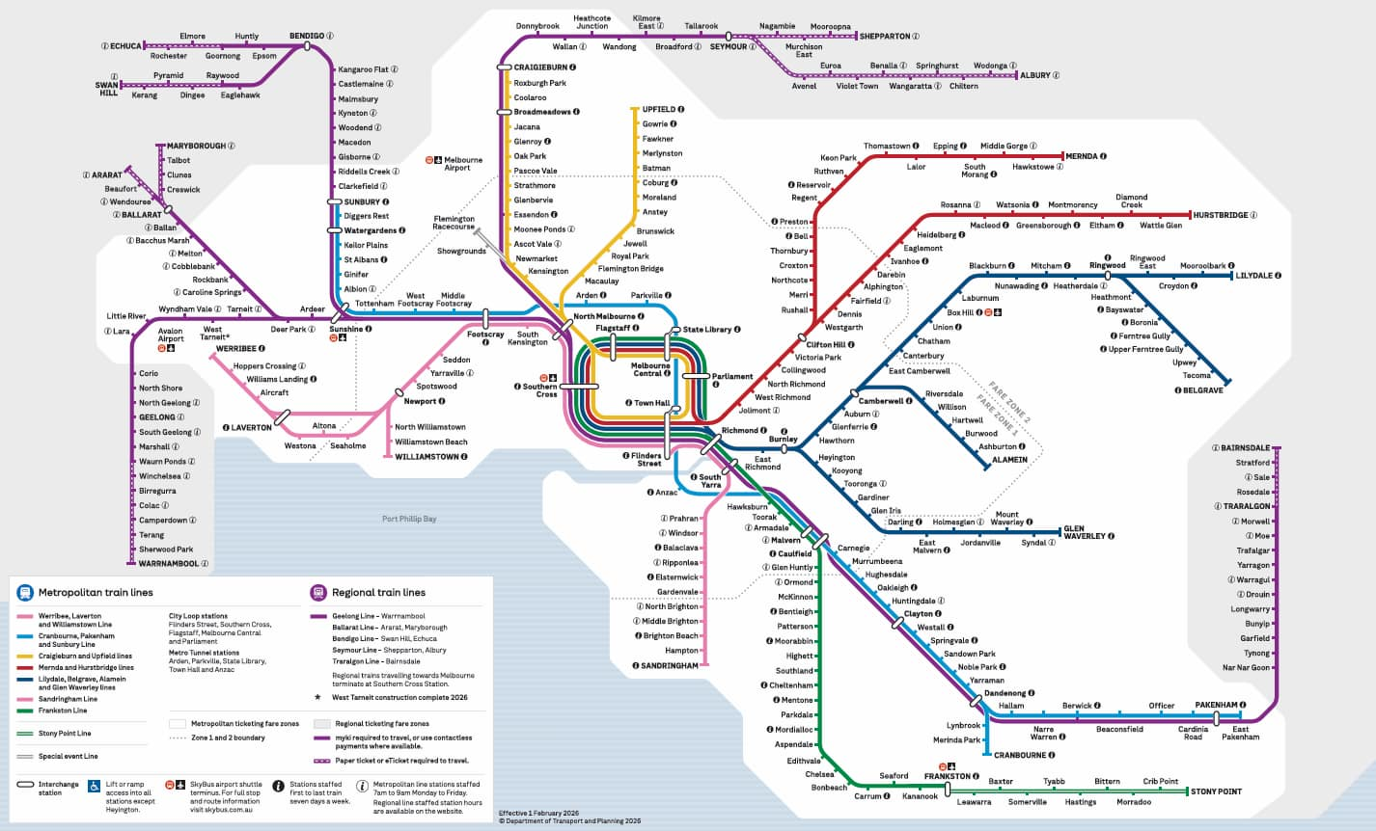

Slide 4
WERRIBEE / WILLIAMSTOWN
North Melbourne
South Kensington
Footscray
Seddon
Yarraville
Spotswood
Newport
Seaholme
Altona
Westona
Laverton
Aircraft
Williams Landing
Hoppers Crossing
Werribee
North Williamstown
Williamstown Beach
Williamstown

Slide 5
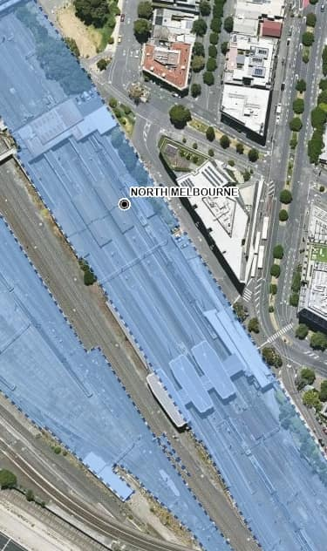
North Melbourne

Slide 6
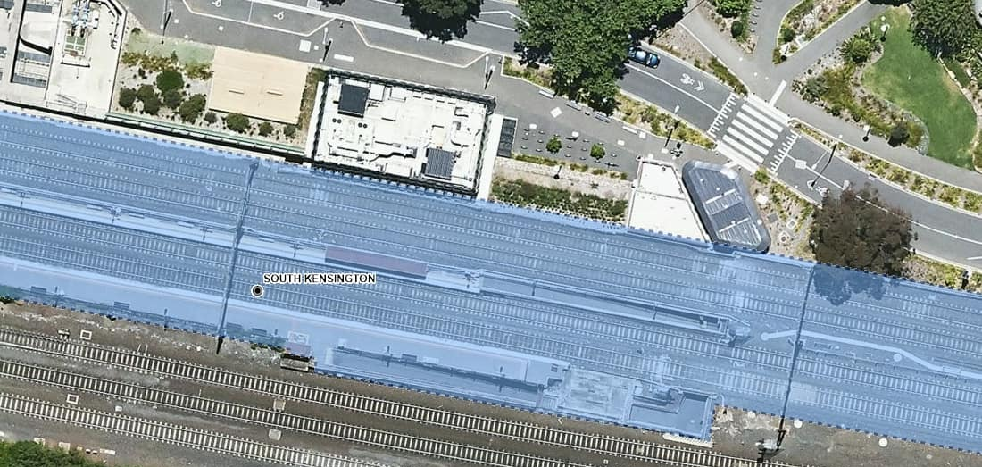
South Kensington

Slide 7
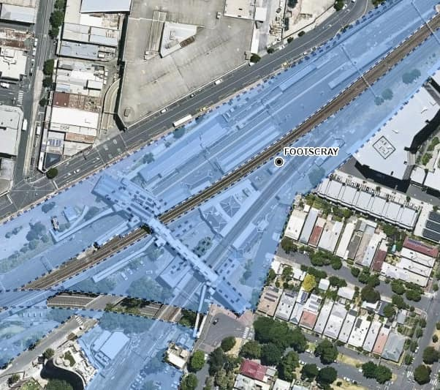
Footscray

Slide 8
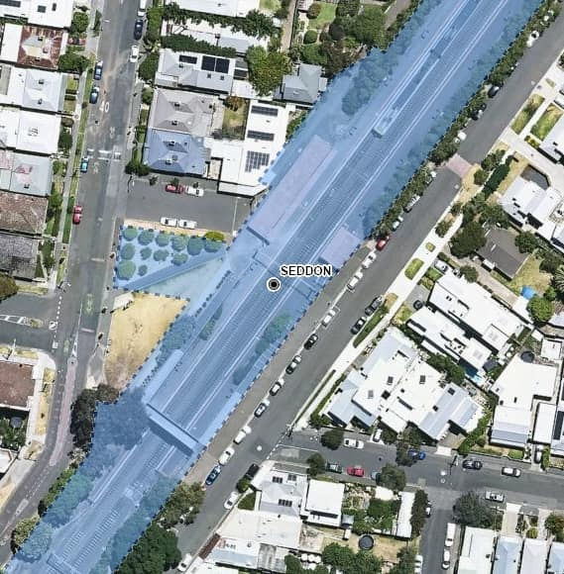
Seddon

Slide 9
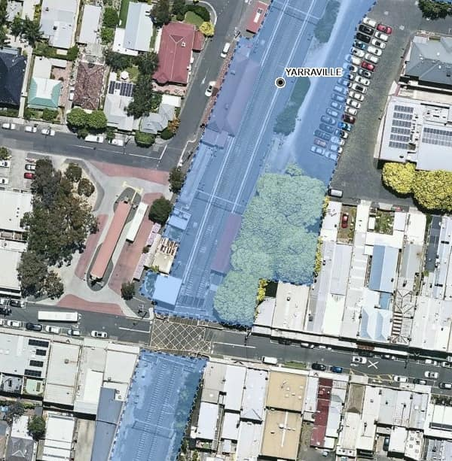
Yarraville

Slide 10
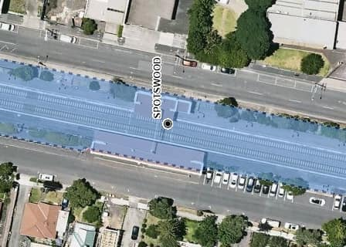
Spotswood

Slide 11
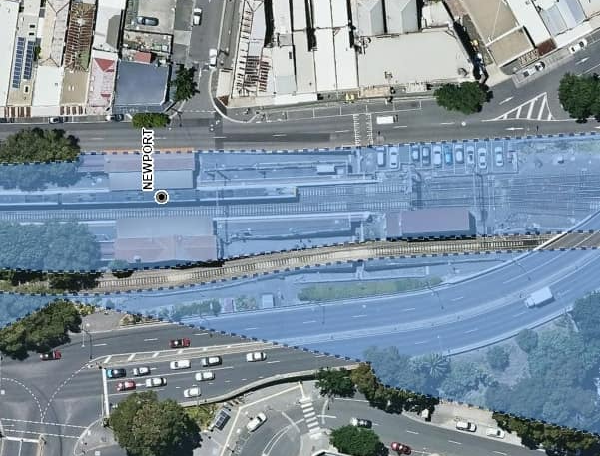
Newport

Slide 12
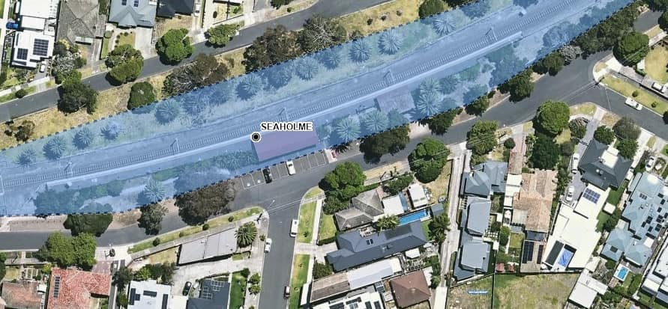
Seaholme

Slide 13
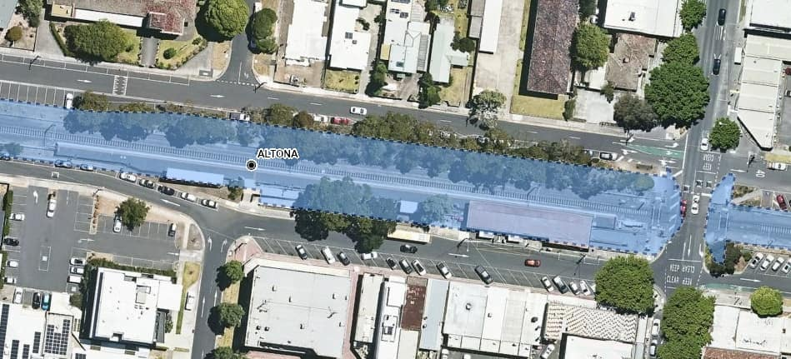
Altona

Slide 14
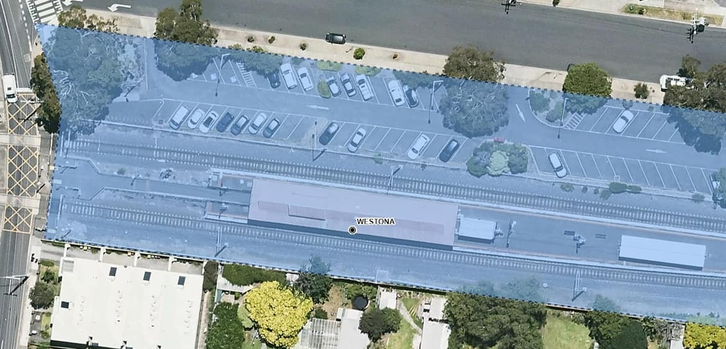
Westona

Slide 15
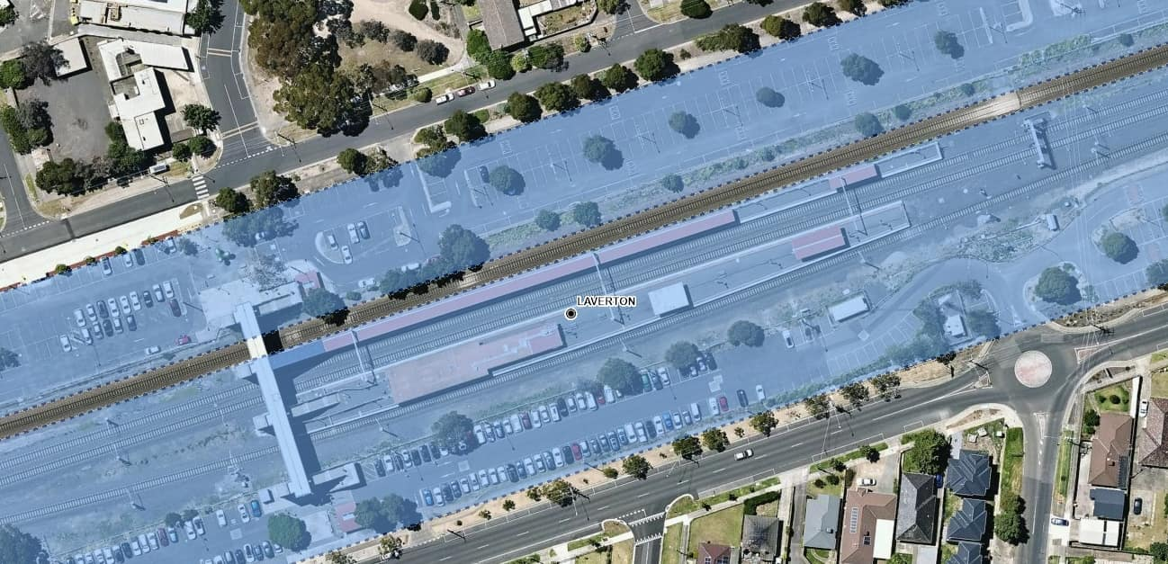
Laverton

Slide 16
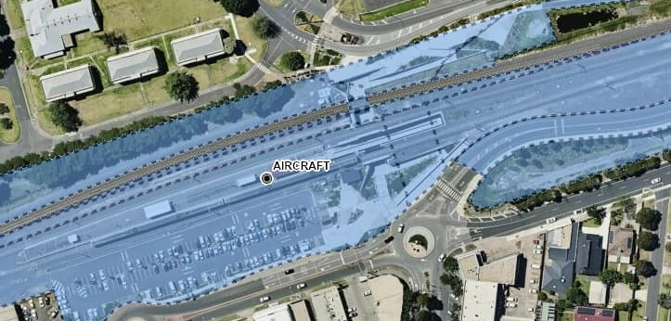
Aircraft

Slide 17
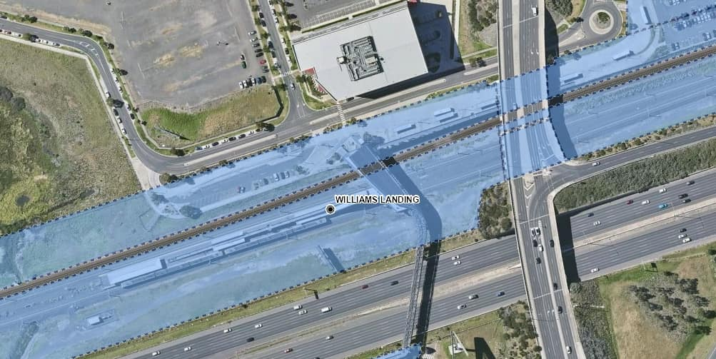
Williams Landing

Slide 18
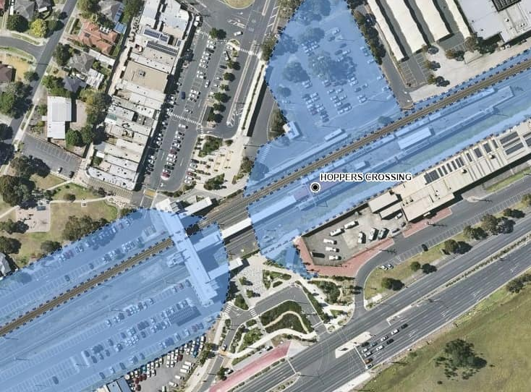
Hoppers Crossing

Slide 19
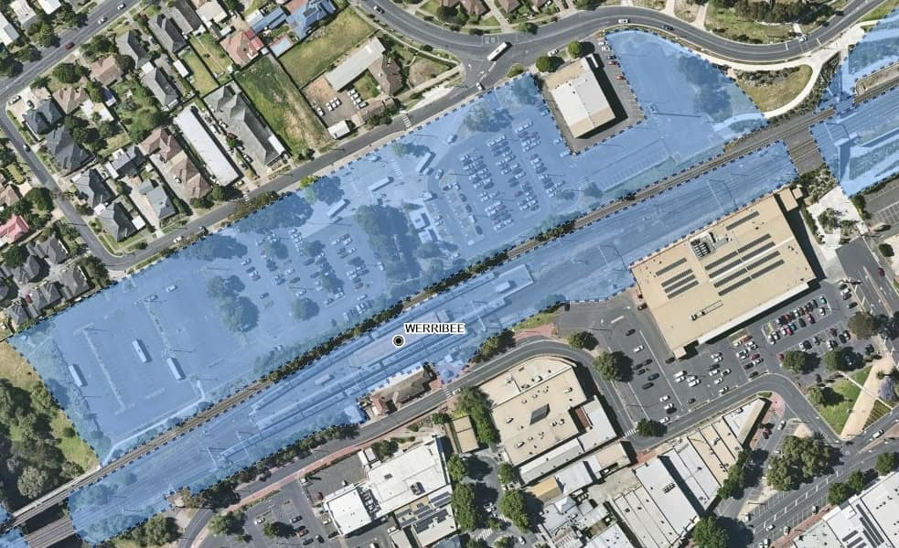
Werribee

Slide 20
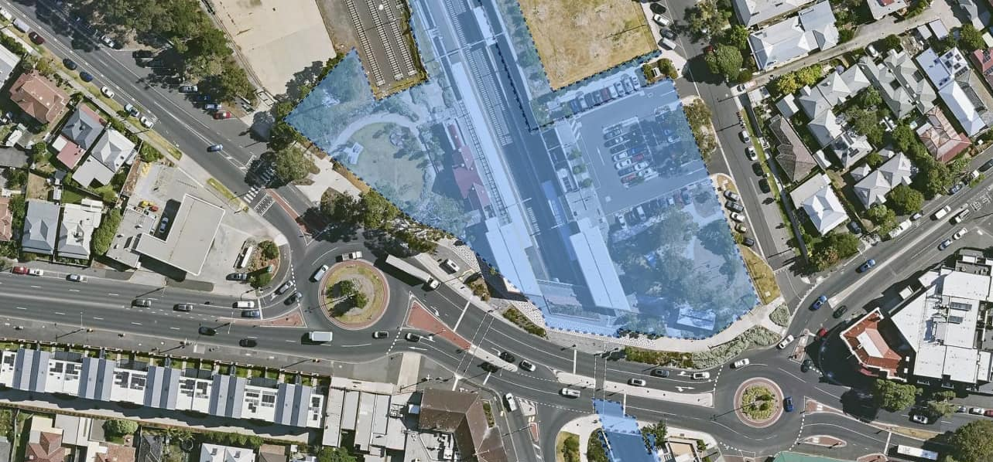
North Williamstown

Slide 21
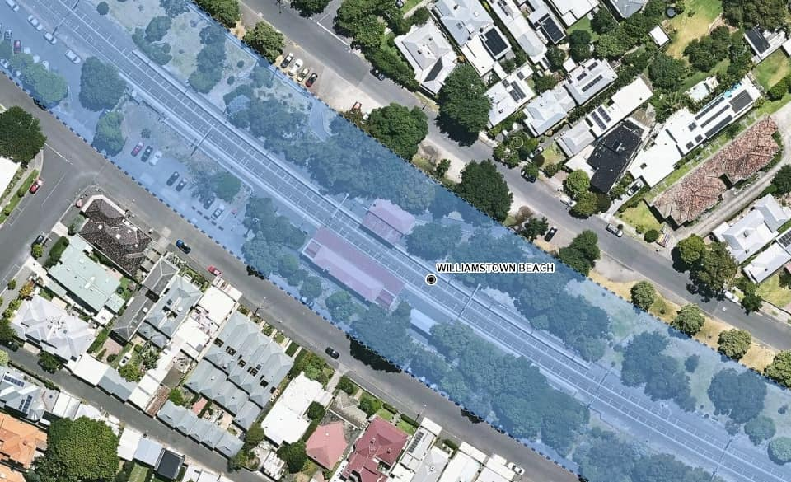
Williamstown Beach

Slide 22
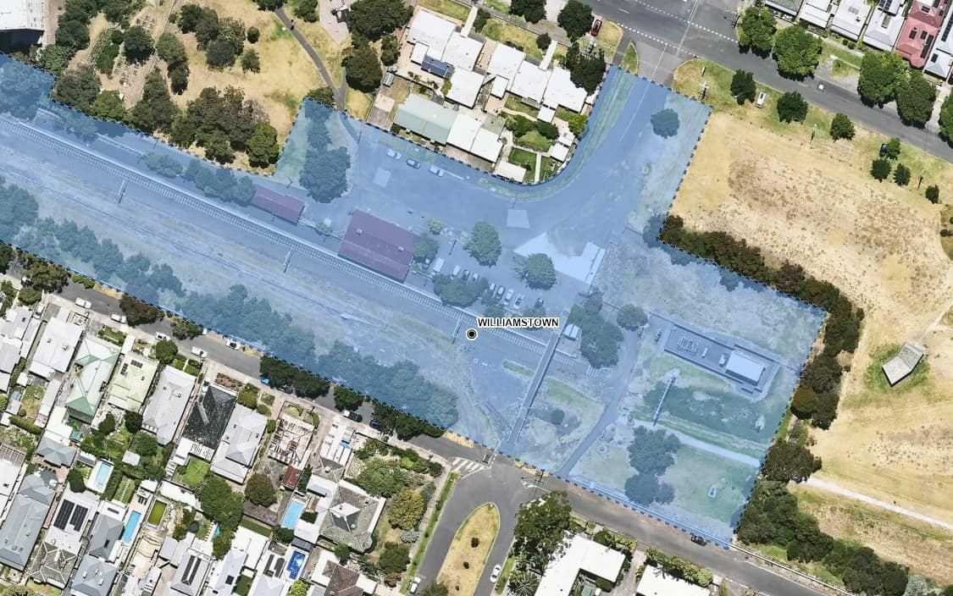
Williamstown

Slide 23
SUNBURY
Footscray
Middle Footscray
West Footscray
Tottenham
Sunshine
Albion
Ginifer
St Albans
Keilor Plains
Watergardens
Diggers Rest
Sunbury

Slide 24
Footscray

Slide 25
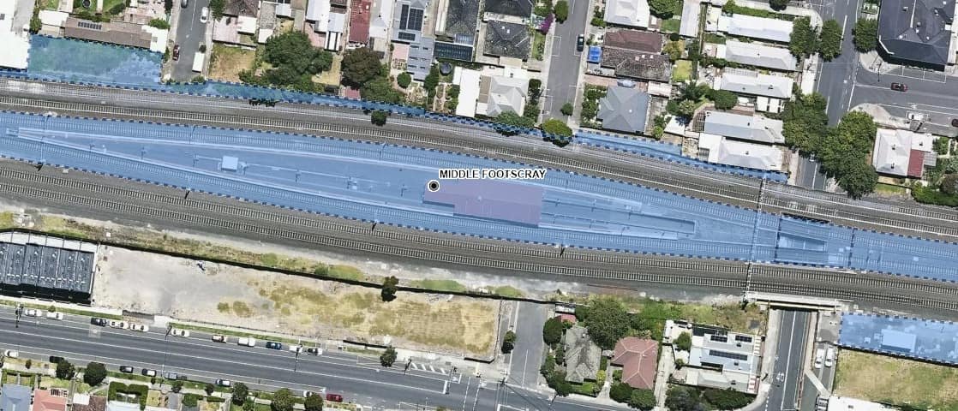
Middle Footscray

Slide 26
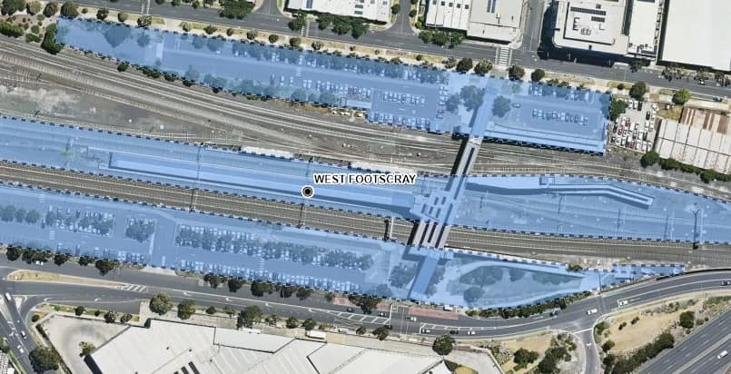
West Footscray

Slide 27
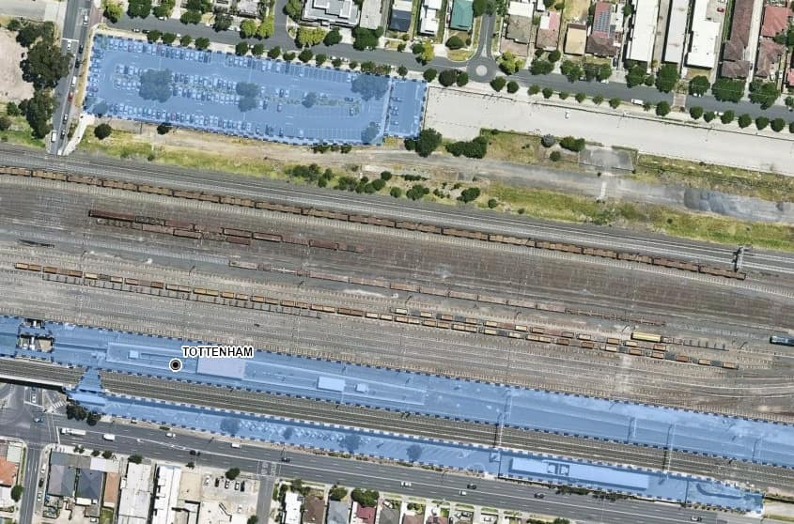
Tottenham

Slide 28
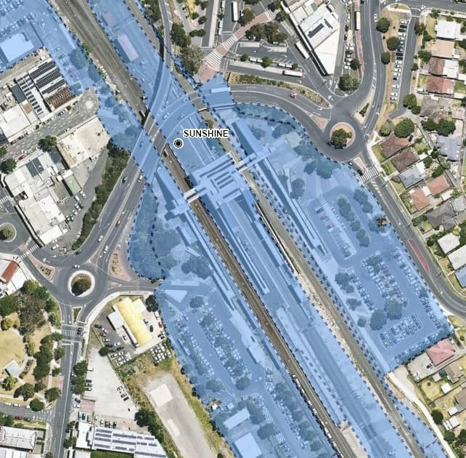
Sunshine

Slide 29
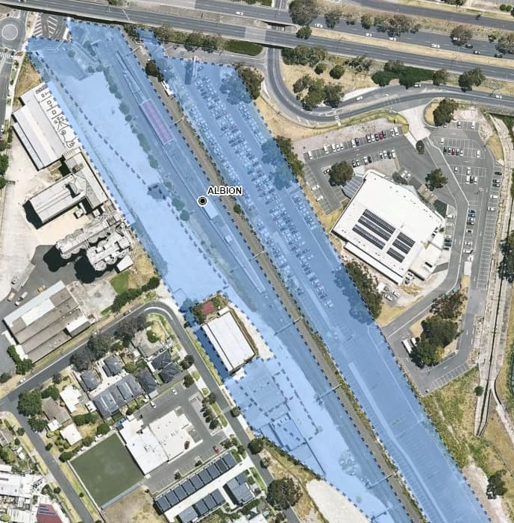
Albion

Slide 30
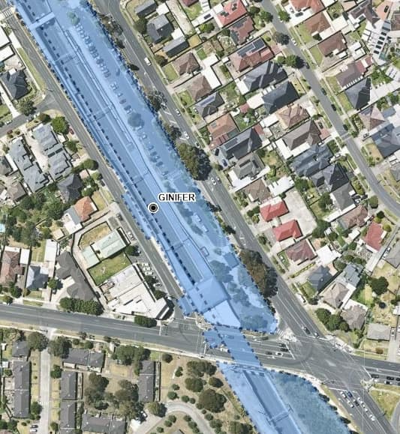
Ginifer

Slide 31
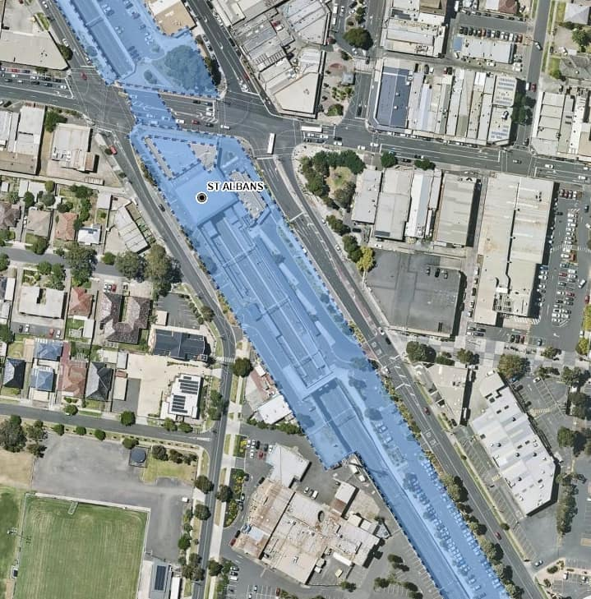
St Albans

Slide 32
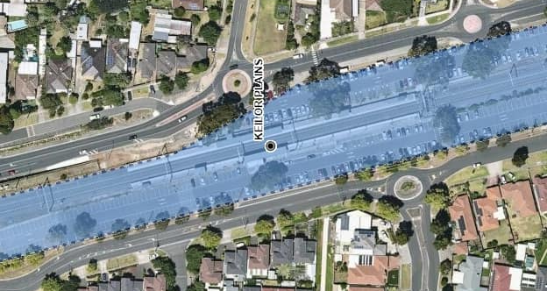
Keilor Plains

Slide 33
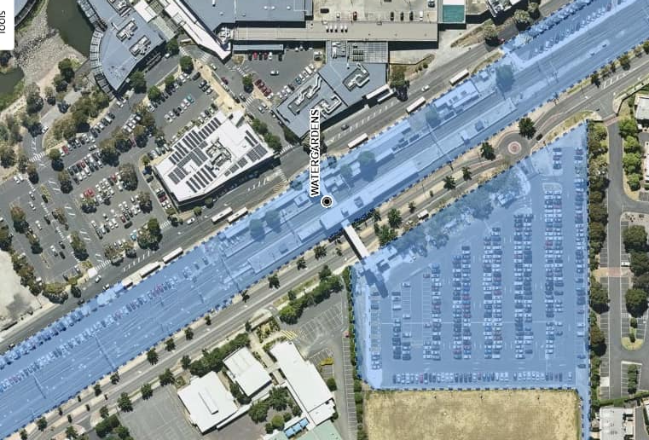
Watergardens Station

Slide 34
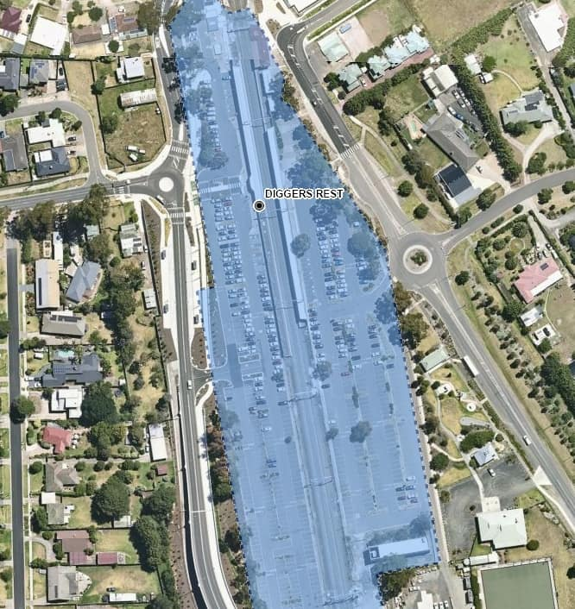
Diggers Rest

Slide 35
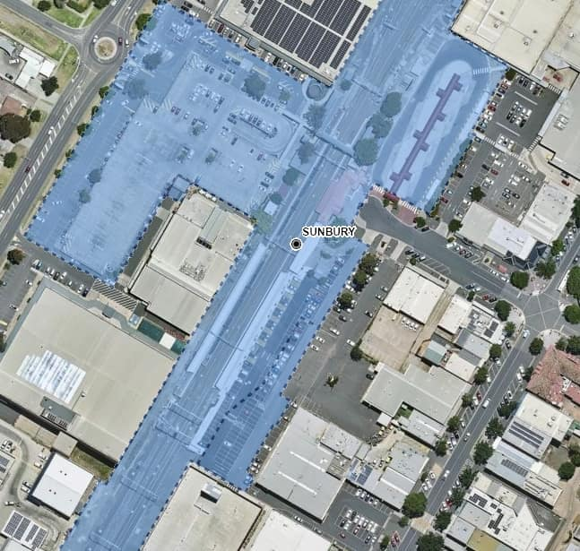
Sunbury

Slide 36
CRAIGIEBURN
North Melbourne
Kensington
Newmarket
Ascot Vale
Moonee Ponds
Essendon
Glenbervie
Strathmore
Pascoe Vale
Oak Park
Glenroy
Jacana
Broadmeadows
Coolaroo
Roxburgh Park
Craigieburn

Slide 37
North Melbourne

Slide 38
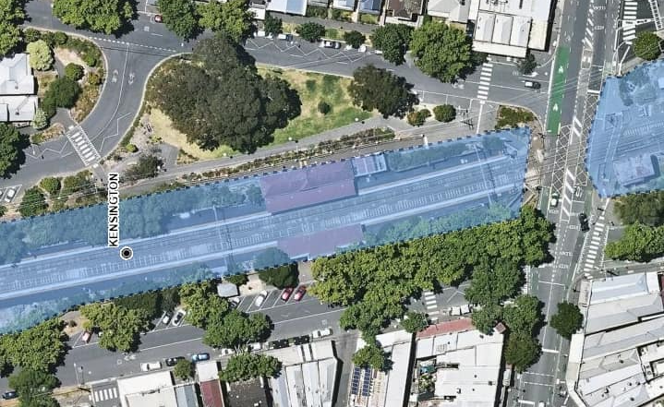
Kensington

Slide 39
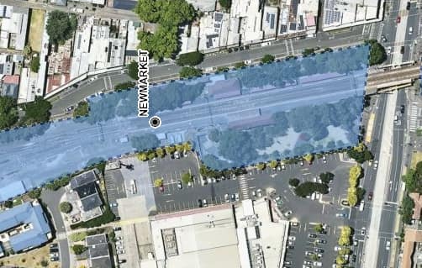
Newmarket

Slide 40
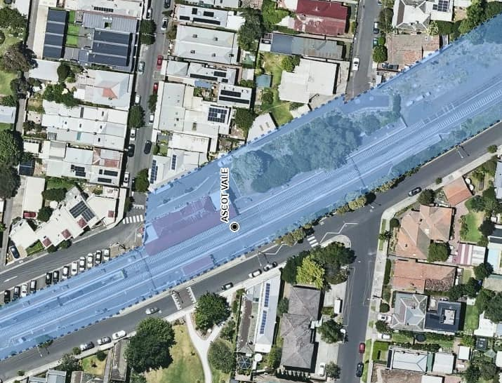
Ascot Vale

Slide 41
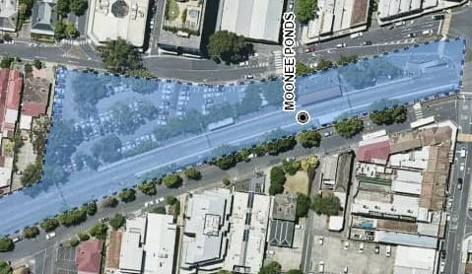
Moonee Ponds

Slide 42
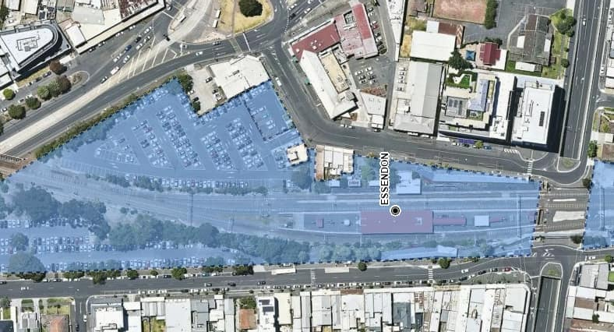
Essendon

Slide 43
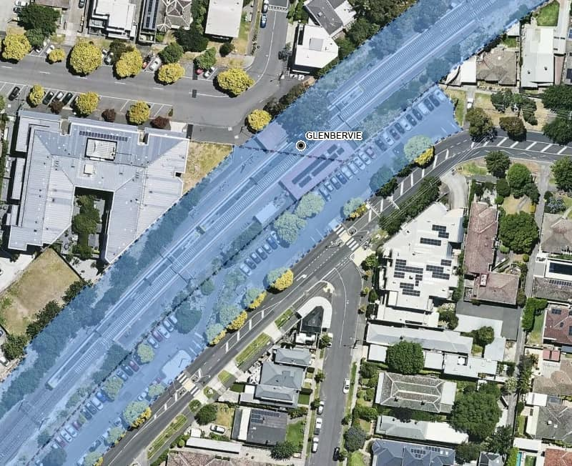
Glenbervie

Slide 44
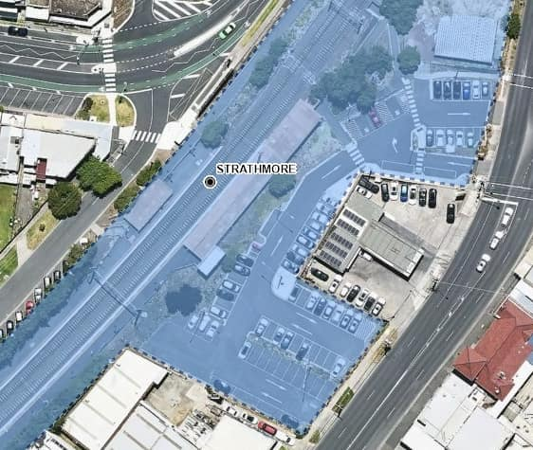
Strathmore

Slide 45
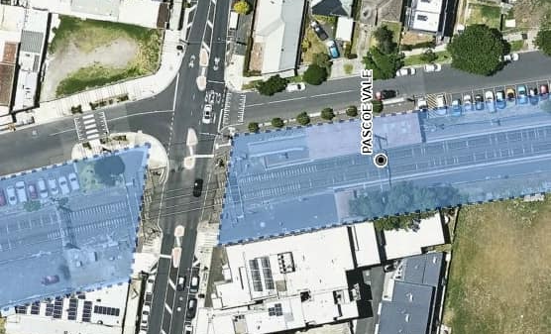
Pascoe Vale

Slide 46
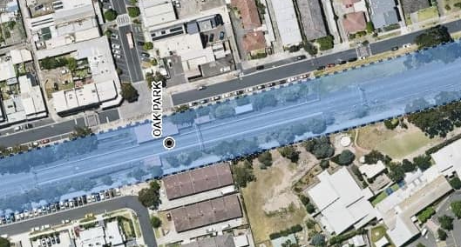
Oak Park

Slide 47
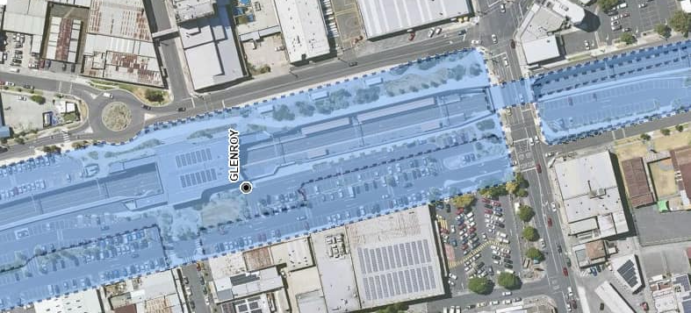
Glenroy

Slide 48
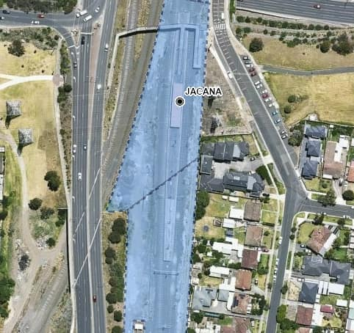
Jacana

Slide 49
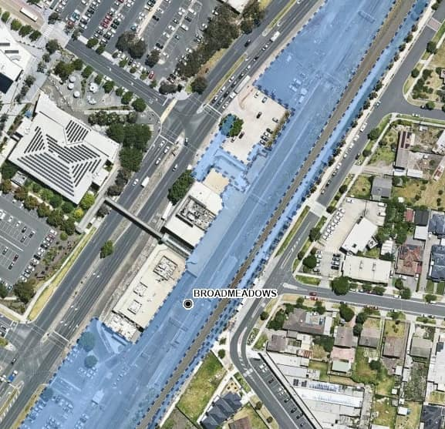
Broadmeadows

Slide 50
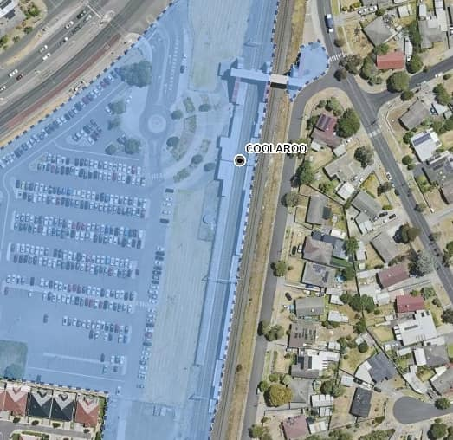
Coolaroo

Slide 51
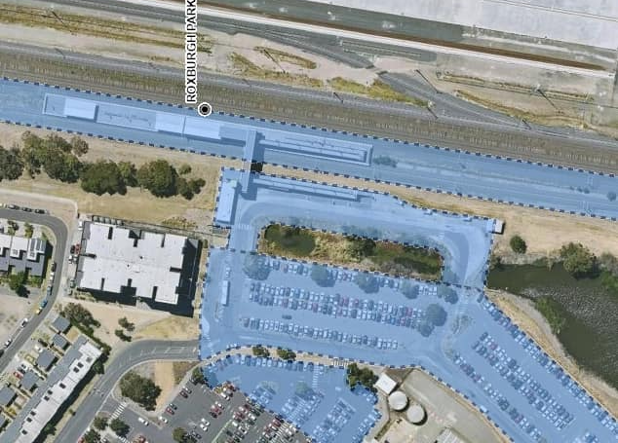
Roxburgh Park

Slide 52
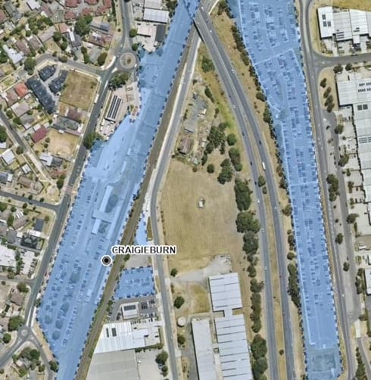
Craigieburn

Slide 53
SHOWGROUNDS
North Melbourne
Showgrounds
Flemington Racecourse

Slide 54
North Melbourne

Slide 55
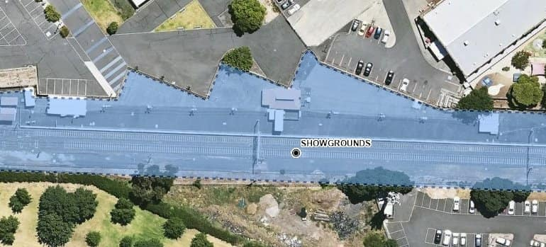
Showgrounds

Slide 56
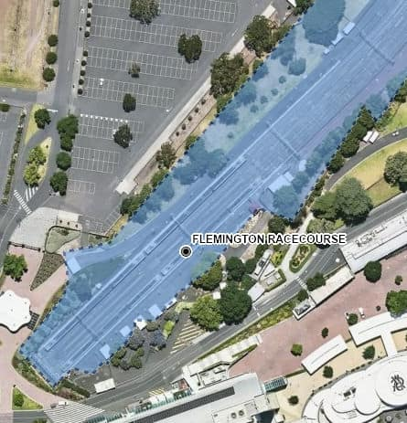
Racecourse

Slide 57
UPFIELD
North Melbourne
Macaulay
Flemington Bridge
Royal Park
Jewell
Brunswick
Anstey
Moreland
Coburg
Batman
Merlynston
Fawkner
Gowrie
Upfield

Slide 58
North Melbourne

Slide 59
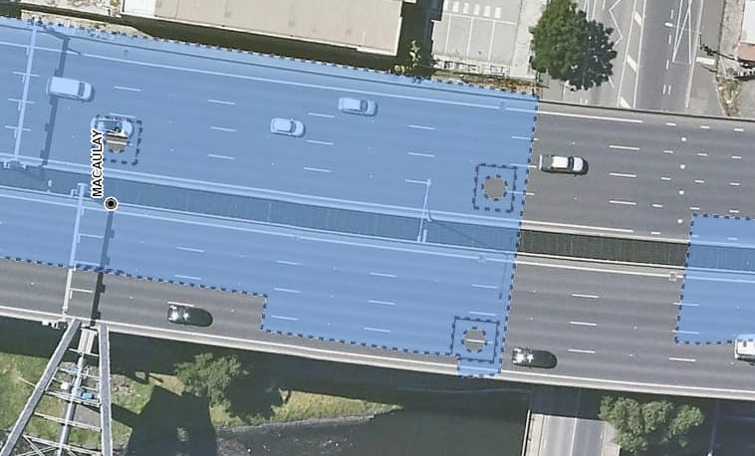
Macaulay

Slide 60
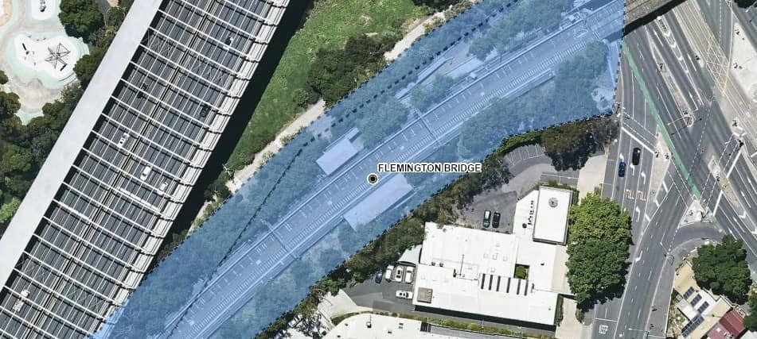
Flemington Bridge

Slide 61
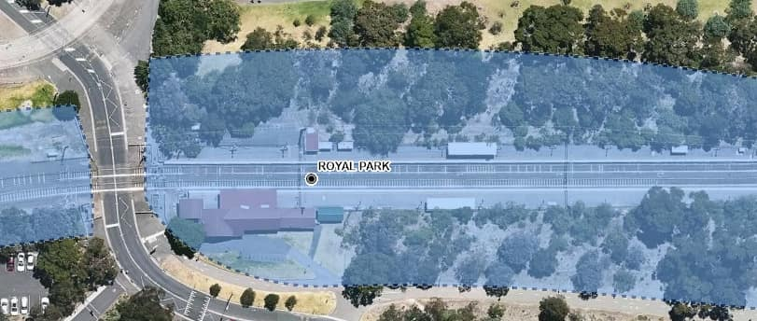
Royal Park

Slide 62

Jewell

Slide 63

Brunswick

Slide 64

Anstey

Slide 65

Moreland

Slide 66

Coburg

Slide 67

Batman

Slide 68

Merlynston

Slide 69

Fawkner

Slide 70

Gowrie

Slide 71

Upfield

Slide 72
SANDRINGHAM
South Yarra
Prahan
Windsor
Balaclava
Ripponlea
Elsternwick
Gardenvale
North Brighton
Middle Brighton
Brighton Beach
Hampton
Sandringham

Slide 73

Richmond

Slide 74

South Yarra

Slide 75

Prahran

Slide 76

Windsor

Slide 77

Balaclava

Slide 78

Ripponlea

Slide 79

Elsternwick

Slide 80

Gardenvale

Slide 81

North Brighton

Slide 82

Middle Brighton

Slide 83

Brighton Beach

Slide 84

Hampton

Slide 85

Sandringham

Slide 86
FRANKSTON
South Yarra
Hawksburn
Toorak
Armadale
Malvern
Caulfield
Glen Huntly
Ormond
McKinnon
Bentleigh
Patterson
Moorabbin
Highett
Southland
Cheltenham
Mentone
Parkdale
Mordialloc
Aspendale
Edithvale
Chelsea
Bonbeach
Carrum
Seaford
Kananook
Frankston

Slide 87
Richmond

Slide 88
South Yarra

Slide 89

Hawksburn

Slide 90

Toorak

Slide 91

Armadale

Slide 92

Malvern

Slide 93

Caulfield

Slide 94

Glen Huntly

Slide 95

Ormond

Slide 96

McKinnon

Slide 97

Bentleigh

Slide 98

Patterson

Slide 99

Moorabbin

Slide 100

Highett

Slide 101

Southland

Slide 102

Cheltenham

Slide 103

Mentone

Slide 104

Parkdale

Slide 105

Mordialloc

Slide 106

Aspendale

Slide 107

Edithvale

Slide 108

Chelsea

Slide 109

Bonbeach

Slide 110

Carrum

Slide 111

Seaford

Slide 112

Kananook

Slide 113

Frankston

Slide 114
STONY POINT
Leawarra
Baxter
Somerville
Tyabb
Hastings
Bittern
Merradoo
Crib Point
Stony Point

Slide 115

Leawarra

Slide 116

Baxter

Slide 117

Somerville

Slide 118

Tyabb

Slide 119

Hastings

Slide 120

Bittern

Slide 121

Morradoo

Slide 122

Crib Point

Slide 123

Stony Point

Slide 124
CRANBOURNE & PAKENHAM LINES
Malvern
Caulfield
Carnegie
Murrumbeena
Oakleigh
Huntingdale
Clayton
Westall
Springvale
Sandown Park
Noble Park
Yarraman
Dandenong
Hallam
Narre Warren
Berwick
Beaconsfield
Officer
Cardinia Park
Pakenham
East Pakenham
Lynbrook
Merinda Park
Cranbourne

Slide 125
Malvern

Slide 126
Caulfield

Slide 127

Carnegie

Slide 128

Murrumbeena

Slide 129

Hughesdale

Slide 130

Oakleigh

Slide 131

Huntingdale

Slide 132

Clayton

Slide 133

Westall

Slide 134

Springvale

Slide 135

Sandown Park

Slide 136

Noble Park

Slide 137

Yarraman

Slide 138

Dandenong

Slide 139

Hallam

Slide 140

Narre Warren

Slide 141

Berwick

Slide 142

Beaconsfield

Slide 143

Officer

Slide 144

Cardinia Park

Slide 145

Pakenham

Slide 146

East Pakenham

Slide 147

Lynbrook

Slide 148

Merinda Park

Slide 149

Cranbourne

Slide 150
Hurstbridge
Jolimont
West Richmond
North Richmond
Collingwood
Victoria Park
Clifton Hill
Westgarth
Dennis
Fairfield
Alphington
Darebin
Ivanhoe
Eaglemont
Heidelberg
Rosanna
Macleod
Watsonia
Greensborough
Montmorency
Eltham
Diamond Creek
Wattle Glen
Hurstbridge

Slide 151

Jolimont

Slide 152

West Richmond

Slide 153

North Richmond

Slide 154

Collingwood

Slide 155

Victoria Park

Slide 156

Clifton Hill

Slide 157

Westgarth

Slide 158

Dennis

Slide 159

Fairfield

Slide 160

Alphington

Slide 161

Darebin

Slide 162

Ivanhoe

Slide 163

Eaglemont

Slide 164

Heidelberg

Slide 165

Rosanna

Slide 166

Macleod

Slide 167

Watsonia

Slide 168

Greensborough

Slide 169

Montmorency

Slide 170

Eltham

Slide 171

Diamond Creek

Slide 172

Wattle Glen

Slide 173

Hurstbridge

Slide 174
Mernda
Jolimont
West Richmond
North Richmond
Collingwood
Victoria Park
Clifton Hill
Rushall
Merri
Northcote
Croxton
Thornbury
Bell
Preston
Regent
Reservoir
Ruthven
Keon Park
Thomastown
Lalor
Epping
South Morang
Middle Gorge
Hawkstowe
Mernda

Slide 175
Jolimont

Slide 176
West Richmond

Slide 177
North Richmond

Slide 178
Collingwood

Slide 179
Victoria Park

Slide 180
Clifton Hill

Slide 181

Rushall

Slide 182

Merri

Slide 183

Northcote

Slide 184

Croxton

Slide 185

Thornbury

Slide 186

Bell

Slide 187

Preston

Slide 188

Regent

Slide 189

Reservoir

Slide 190

Ruthven

Slide 191

Keon Park

Slide 192

Thomastown

Slide 193

Lalor

Slide 194

Epping

Slide 195

South Morang

Slide 196

Middle Gorge

Slide 197

Hawkstowe

Slide 198

Mernda

Slide 199
Lilydale
Richmond
East Richmond
Burnley
Hawthorn
Glenferrie
Auburn
Camberwell
East Camberwell
Canterbury
Chatham
Union
Box Hill
Laburnam
Blackburn
Nunawading
Mitcham
Heatherdale
Ringwood
Ringwood East
Croydon
Mooroolbark
Lilydale

Slide 200
Richmond

Slide 201

East Richmond

Slide 202

Burnley

Slide 203

Hawthorn

Slide 204

Glenferrie

Slide 205

Auburn

Slide 206

Camberwell

Slide 207

East Camberwell

Slide 208

Canterbury

Slide 209

Chatham

Slide 210

Union

Slide 211

Box Hill

Slide 212

Laburnum

Slide 213

Blackburn

Slide 214

Nunawading

Slide 215

Mitcham

Slide 216

Heatherdale

Slide 217

Ringwood

Slide 218

Ringwood East

Slide 219

Croydon

Slide 220

Mooroolbark

Slide 221

Lilydale

Slide 222
Glen Waverley
Richmond
East Richmond
Burnley
Heyington
Kooyong
Tooronga
Gardiner
Glen Iris
Darling
East Malvern
Holmesglen
Jordanville
Mount Waverley
Syndal
Glen Waverley
Riversdale
Willison
Hartwell
Burwood
Ashburton
Alamein
Heathmont
Bayswater
Boronia
Ferntree Gully
Upper Ferntree Gully
Upwey
Tecoma
Belgrave

Slide 223
Richmond

Slide 224
East Richmond

Slide 225
Burnley

Slide 226

Heyington

Slide 227

Kooyong

Slide 228

Tooronga

Slide 229

Gardiner

Slide 230

Glen Iris

Slide 231

Darling

Slide 232

East Malvern

Slide 233

Holmesglen

Slide 234

Jordanville

Slide 235

Mount Waverley

Slide 236

Syndal

Slide 237

Glen Waverley

Slide 238
Alamein
Riversdale
Willison
Hartwell
Burwood
Ashburton
Alamein
For Camberwell – City, see Lilydale

Slide 239

Riversdale

Slide 240

Willison

Slide 241

Hartwell

Slide 242

Burwood

Slide 243

Ashburton

Slide 244

Alamein

Slide 245
Belgrave
Heathmont
Bayswater
Boronia
Ferntree Gully
Upper Ferntree Gully
Upwey
Tecoma
Belgrave
For Ringwood – City, see Lilydale

Slide 246

Heathmont

Slide 247

Bayswater

Slide 248

Boronia

Slide 249

Ferntree Gully

Slide 250

Upper Ferntree Gully

Slide 251

Upwey

Slide 252

Tecoma

Slide 253

Belgrave

